Slide 1


Write for a Living

Slide 2
Session 2:
Write for a Living
Write for a Living
Mentors: Daniella Penn, Liran Wiezman Language: Ruby Mission: Get Data
Wednesday, December 14, 2016, 215 Lex Graphics Lab 6::30PM

Slide 3
Why learn Ruby?
The average salary is: $96, 754
It is easy to learn
You can build cross platform (IOS/Android/Google/Windows)
Ruby on Rails
Let’s get started!
Notes:
http://www.bestprogramminglanguagefor.me/why-learn-ruby
http://www.skilledup.com/articles/4-reasons-learn-ruby-first-programming-language
Pry Gem- binding.pry

Slide 4
Learn Ruby in 20 Minutes: Go to Link

Slide 5
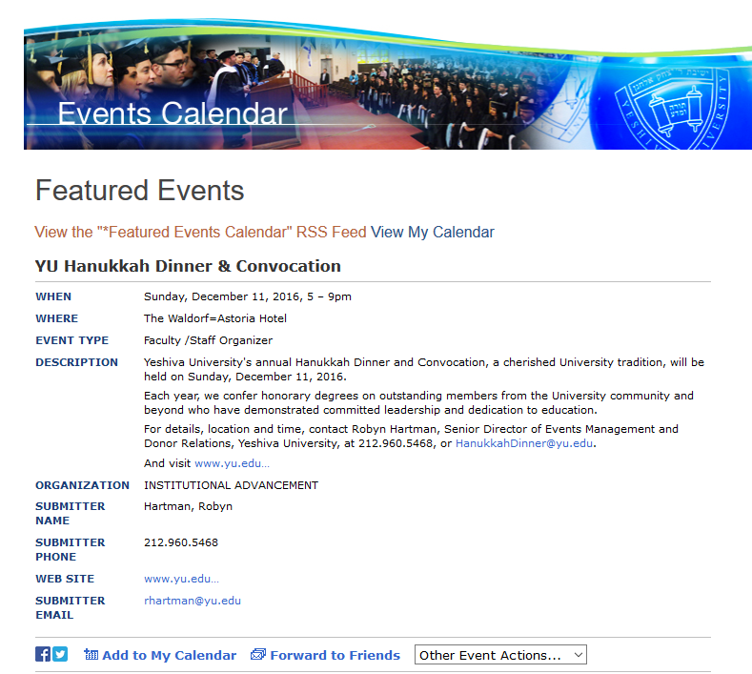
yu.edu/events
Notes:
What data do we have? What data do we need?

Slide 6
What data do we have?
What data do we need?

Slide 7

Write for a Living
Thank you to: Aviva Childress, Riva Tropp, Daniella Penn, Ilana Radinsky, Gal Gir, Racheli Moskowitz, Ahuva Hoverman, Chana Schiffmiller & Meredith Shapiro

